Slide 1

Sprint 4 Presentation
Jenna Esposito, Anthony Pastorelli, Thérèse Racancoj

Slide 2
Challenges faced
We did not give ourselves enough time to work on the code to make it perfect
Not getting the exact circle size for the figure 8
We spent too much time on sprint 1, which gave us less time for sprint 2

Slide 3
Roles of Each Member
Each member was required to meet at least every week after Thursday’s class. During this time we would work on the block code, system design document, and talk about the progress of each sprint.
Ez was known as ‘the editor’. Her responsibilities included filling out the requirements table, creating flowcharts, and putting the finishing touches on the SDD.
Anthony’s main responsibility was chart maintenance. He made sure the requirements sign-off, test table, and Gantt chart was updated.
Jenna’s role was to be the manager. Her responsibilities included, organizing the staffing plan/deadlines, writing the algorithms, working with the block code, and managing the GitHub repository.
Even though we all had assigned roles, when it was necessary, we all helped each other out with whatever needed to be done

Slide 4
What we learned
We learned how to use the Sphero block code
Practiced our time management skills
Practiced our communication and teamwork skills

Slide 5
What we would do differently
Spend less time on sprint 1
Start sprint 2 earlier
Go over each other’s work more thoroughly
Start recording earlier
Be more organized with schedules

Slide 6
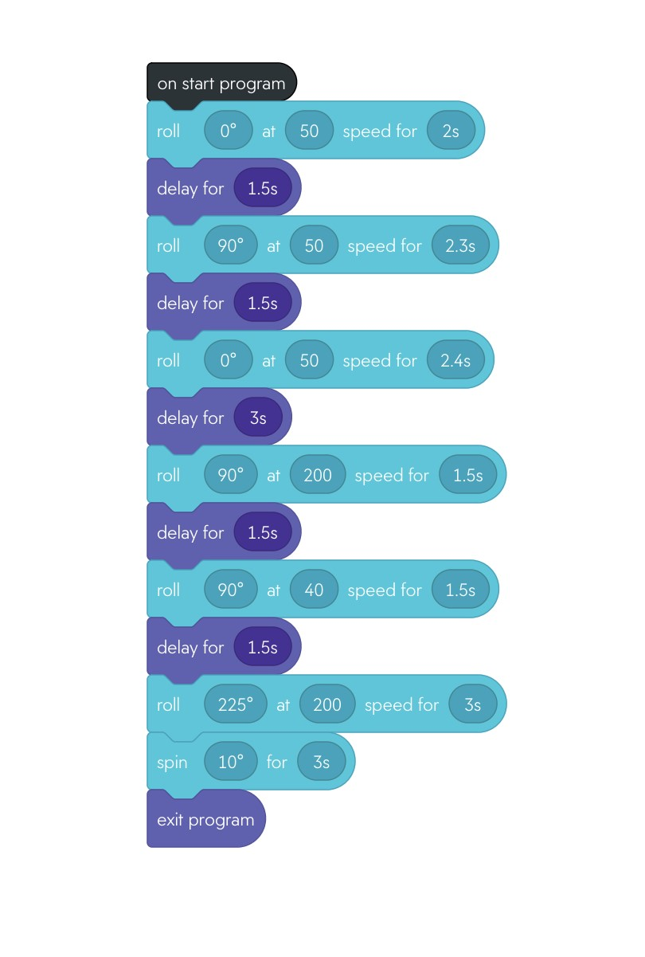
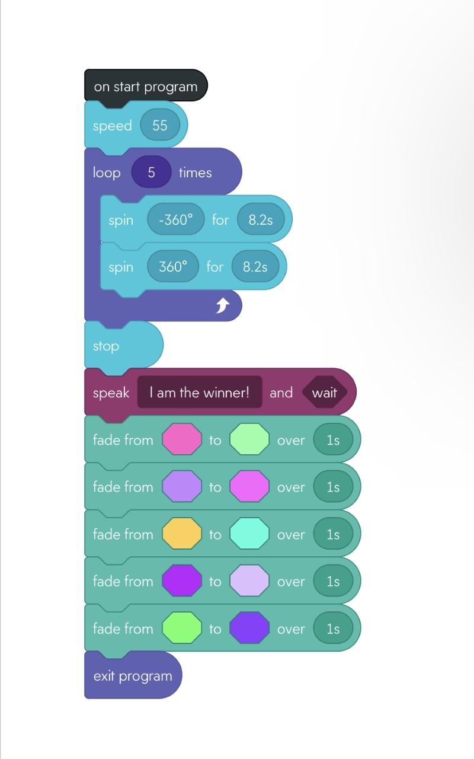
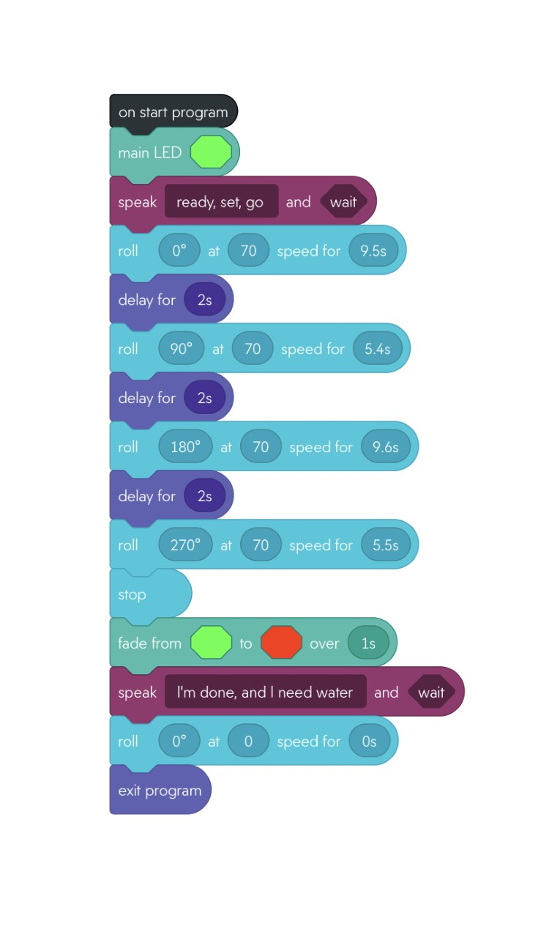
Block code

Slide 7
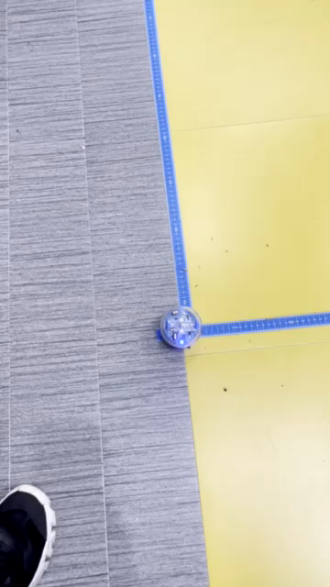
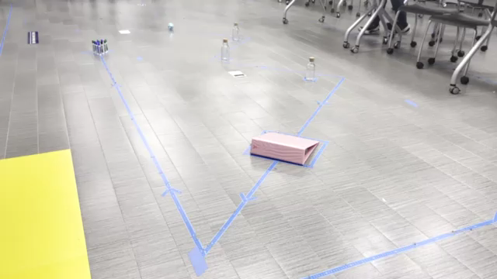
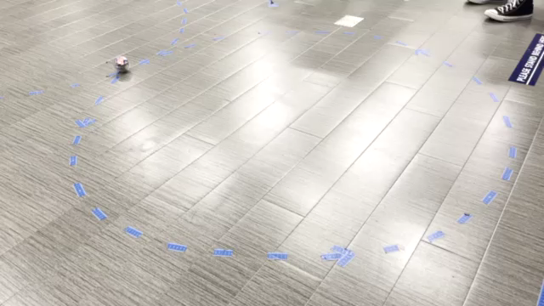
Videos of Sprints
https://github.com/jesposito21/Sprint-4-Presentation.git

